Slide 1

Metacognition in the Classroom
Diana Epelbaum, Ph.D.
Academic Writing
C-TIE
September 25, 2019

Slide 2

Invisible Writing
Freewrite:
What does “metacognition” mean to you? What does “metacognition” mean in the context of teaching?
Place the carbon paper between 2 white sheets and use the tip of the mechanical pencil without using the graphite itself.
You will be composing invisibly, so do your best!

Slide 3
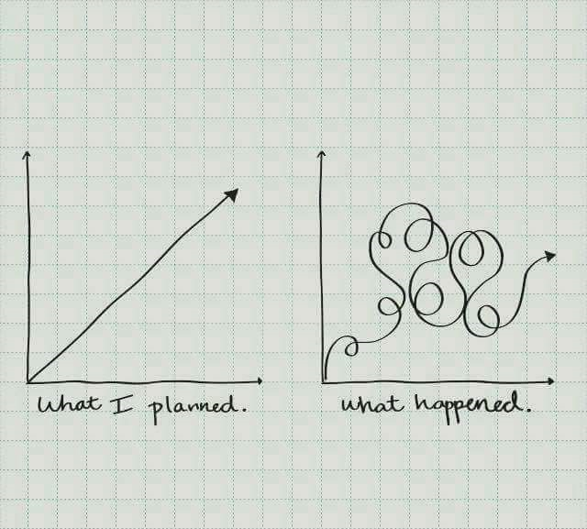
Invisible Writing Reflection
What did it feel like to write “invisibly,” without seeing your words on the page?
Exercise from Sheridan Blau,“Invisible Writing” (1983)
  All writers use “scanning” to make meaning as they write
  Student writers generally “scan” a good deal more than professional writers during invention (Sondra Perl), and this starting and stopping can be inhibitory to thinking and sustained focus
  The theory of writing “stages” is not quite right
1
2
3
4
5
6

Slide 4

What is Metacognition?
“Thinking about thinking” or, “Learning about learning”.””
Awareness of the self, of your thinking, in the process of doing: outside of the doing itself. The act and the awareness of the act. Going beyond or above the thing itself. Watching yourself. Self-referential.
The meta classroom is very introspective and reflective and also deeply critical and analytic.
It means emphasizing how and why students are completing tasks. It means connecting these tasks to other tasks both in your class and outside of your class.

Slide 5
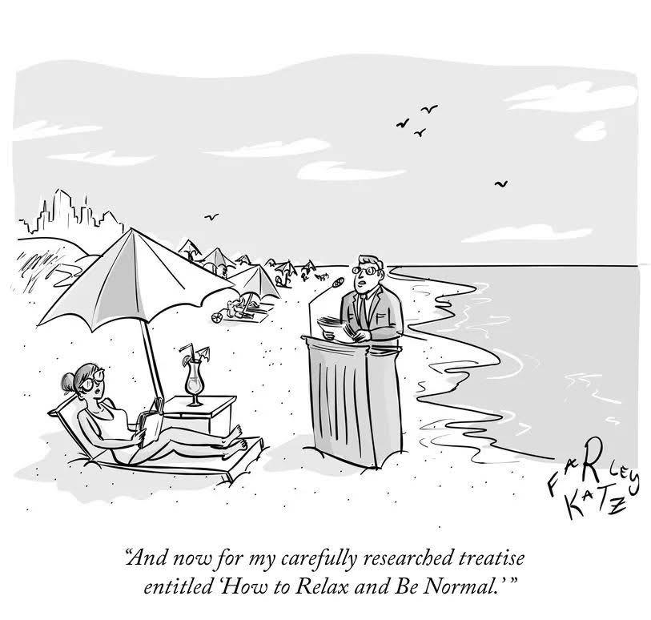
What is Metacognition?
It means developing a rhetorical vocabulary for big ideas about [your discipline/work in the course]. In writing these are things like rhetoric, context/situation, audience, purpose, genre, evidence, discourse communities, which all disciplines likewise emphasize.
Beyond the how and why and connectivity of tasks and activities, in writing, this looks like taking note of individual writing processes, habits, practices, emotional, mental, physical barriers to composition, and rigorously interrogating these in order to develop effective, individualized strategies for moving past these barriers.
This level of awareness is cognitive, social, emotional, and visceral (embodied), transforming students’ attitudes towards the subject, advancing both knowledge and skill.

Slide 6

Metacognition Builds a Bridge
How much of what we believe we are teaching are students learning?
Metacognition helps bridge the disconnect.
It makes our meaning visible to students so that then they can proceed to develop self-efficacy for tasks that are specific to your discipline and also for tasks that they can draw on an arsenal of tools to handle across contexts.
We can do any number of big and small things to make these connections for students more clear and to facilitate their own connection-building.
In the process, they might learn something other than, or more than, we are teaching—if you and they are aware of this, have open conversations about this, it’s great!

Slide 7


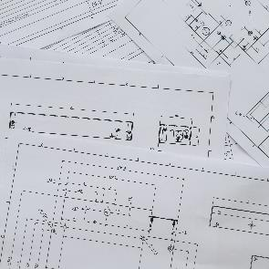



What Are Threshold Concepts?
“Threshold Concepts are concepts critical for continued learning and participation in an area or within a community of practice…”
Jan H.F. Meyer and Ray Land who first defined threshold concepts (cited/paraphrased in Adler-Kassner and Wardle):
“Learning [threshold concepts] is generally transformative, involving an ‘ontological as well as a conceptual shift…becoming a part of who we are, how we see, and how we feel.
Once understood, they are often irreversible and the learner is unlikely to forget them.
They are integrative, demonstrating how phenomena are related, and helping learners make connections.
They tend to involve forms of troublesome knowledge… ‘alien’ or counterintuitive” (3).
1
2
3
4
5
6

Slide 8

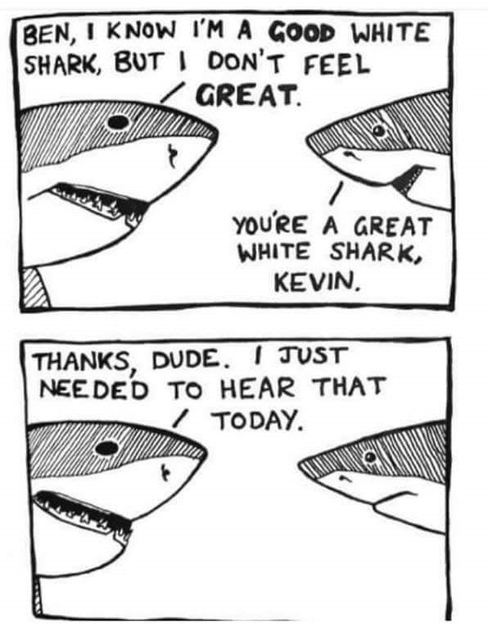
Student “Writing Identity Blogs”
While threshold concepts typically refer to disciplinary knowledge, threshold concepts in writing can refer to both discipline-specific and interdisciplinary knowledge.
There is a difference between “knowing” and “knowing” as a threshold concept. A threshold concept is deeply ingrained and affects your practice—but, it is a long journey to get to that knowing.
Blog Threshold Concepts:
→“We are always evolving as writers and thinkers”
→“In order to evolve as writers and thinkers, we need to actively make connections between disciplines, modes, ideas, and our personal and academic lives.”
WordPress
Instagram

Slide 9

Threshold Concepts in Writing from Academic Writing Faculty
There are multiple views to each argument
Research is dialogue
Words have different meanings based on context (academic/real-world)
There is freedom within the rules
Writing is paying attention/looking closely
Writing is Thinking
Detail matters/There is no such thing as final
Writing is the extension of your person
You are not your writing
Feedback is not a critique of YOU
Writing is a process, not product
A good writer is a good reader
“The pleasure’s in the journey, not the destination.”
Writing can be torture, and that’s ok
Writing is a skill that requires practice—not knowledge
“Failure” is a normal and important part of the writing process
All of our composing processes are different
Writing is recursive: revision happens in all stages of the writing
process, not just at the end
Data A
Data B
Data C

Slide 10
Freewrite
Articulate and/or develop a threshold concept that’s important to you that you want your students to grapple with, move closer towards (not master) in their time with you.

Slide 11

Application: Groups of 3
2 faculty/staff, 1 student
Talk through the threshold concept you began to explore in your freewrite
Begin jotting down ideas and talking through how you can help students move towards deep understanding of this concept. Here, you might think about things you already do, as well as generate an idea or two about what you can do. Students can help you brainstorm!
When you generate ideas, you can think BIG or small:
A fun activity like invisible writing
Assignments, projects, tasks
Class discussions
Metacognition scripts for any work in the course
Think about what you’re doing this week and what small metacognitive piece you can add to build towards that threshold concept!

Slide 12
Works Cited
Adler-Kassner, Linda, and Elizabeth Wardle. Naming What We Know: Threshold Concepts of Writing Studies. Utah State U.P., 2015. Print.
Blau, Sheridan. “Invisible Writing: Investigating Cognitive Processes in Composition.” College Composition and Communication, vol. 34, no. 3, Oct. 1983, pp. 297-312. JSTOR, http://www.jstor.org/stable/358261.
Perl, Sondra. “The Composing Processes of Unskilled College Writers.” Research in the Teaching of English, vol. 13, no. 4, 1979, pp. 317–336. JSTOR, www.jstor.org/stable/40170774.
Wardle, Elizabeth, and Doug Downs. Writing About Writing: A College Reader. Bedford/St. Martin’s, 2011. Print.

Slide 13
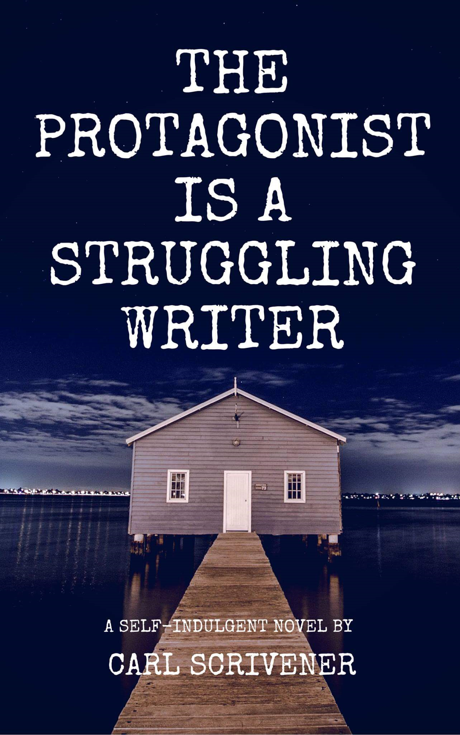

Thank You
Diana Epelbaum
depelbaum@mmm.edu

