Slide 1
Teaching & Learning with Technology
C-TIE Presentation for 9/26/18

Slide 2
Why Use Technology?
More efficient
More immediate, real-time
The separation of personal and professional is long gone
Students currently live there (Consumerization)

Slide 3
How to use technology effectively?
As a substitute:
  Grading, setting multiple choice assignments
  Collecting papers with an accurate timestamp
  Tallies the difficult questions quickly
As Augmentative:
  Repository for examples of previous students’ works
  Library of class materials
  Post class notes and reminders/announcements/edits
As Modification:
  Redesign class papers as blogs that are posted for the full class to read
  Make presentations virtual and video based
As Redefinition of Pedagogy

Slide 4
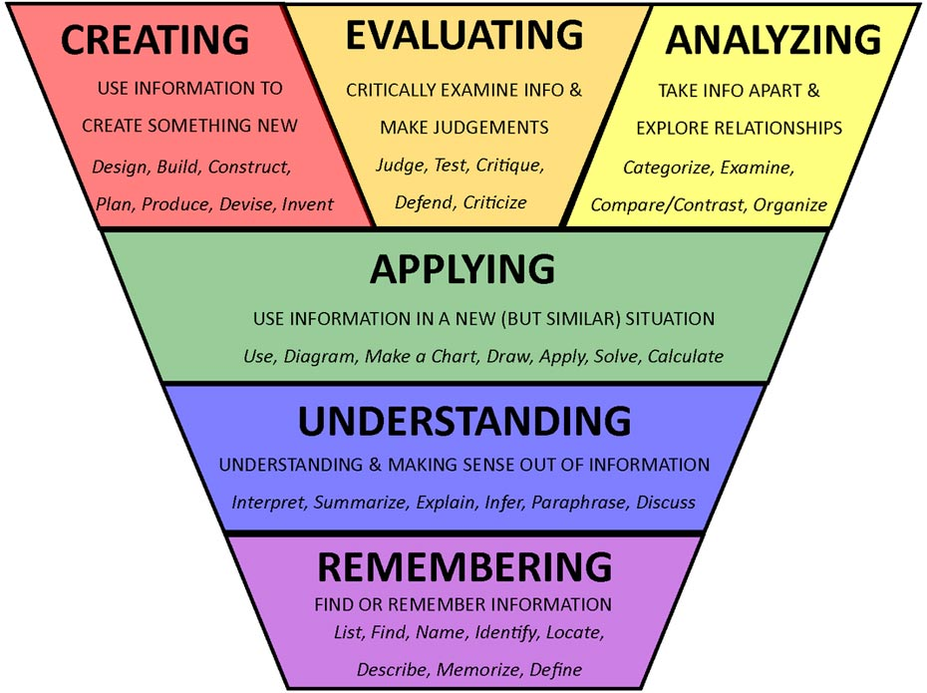
Can Technology Redefine Pedagogy?
E-learning affords On-Demand:
  Scale
  Can be asynchronous
  Can be iterative until 100% mastery of a topic
  Democratization of education
Technology is already redefining how we learn, what we learn and why we learn it
Bloom’s Taxonomy

Slide 5
Evolving Tools for Tech-Enabled Learning
  For Remembering:
  “Smart” textbooks that prompt knowledge checks and practice questions
  Test banks that scaffold automatically based on the last correct/incorrect answer
  For Understanding:
  Create a Wiki
  Socrative
  PollDaddy
  Make Your Own Jeopardy (towards gamification)
  For Applying:
  Online Interactive White Boards
  Simulation games that mimic search engine results (Digital Marketing)
  For Creating (and posting, and liking, and sharing):
  Twitter/Instagram/Facebook (open platforms)
  Pinterest
  SnapChat
  YoutTube Channels
  Discussion Boards
  ListServs
  Blog posts
  Vlogs
  PowToon
  MindMeister
Bloom’s Taxonomy

Slide 6
Future of Tech-Enabled Learning
The Analysis and Evaluation aspects will improve because of predictive technology
Education is no longer the differentiator: skills are
Is this the end of lecture-driven classrooms?

