Slide 1
Open Educational Resources (OER) and
Zero Textbook Cost Degrees (Z-Degrees)
Michelle Ronda
Borough of Manhattan Community College (BMCC)/CUNY
Marymount Manhattan College C-TIE: Wednesday, April 25, 2018

Slide 2
What are Open Educational Resources?
OER (Open Educational Resources) are teaching, learning, and research resources that reside in the public domain or have been released under an intellectual property license that permits their free use and repurposing by others.
OER include full courses, course materials, modules, textbooks, streaming videos, tests, software, and any other tools, materials, or techniques used to support access to knowledge.
Free is not necessarily open; Priority of the 5 Rs
  Many resources may be free but not open | Example: The Marshall Project

Slide 3
Why pursue a Zero Textbook Cost degree?
Textbook reserves: An imperfect solution
Textbook/supplies affordability and student success
  Estimates by College Board of $1200/year on course materials per student
  CUNY students: Over 50% from households with < $20,000 incomes
  Faculty frustration/disappointment with existing materials
Z-Degree (Zero Textbook Cost)
  24 courses with at least one section of every required course as ZTC
  Searchable by students
E-Learning is not OER (but they do complement each other)

Slide 4
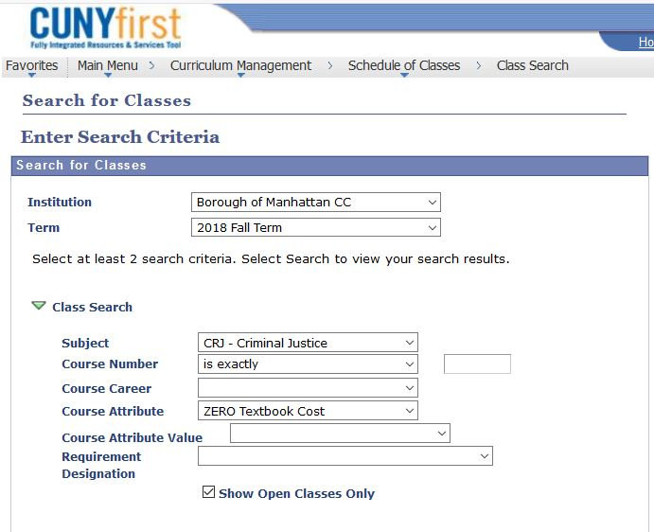

Slide 5
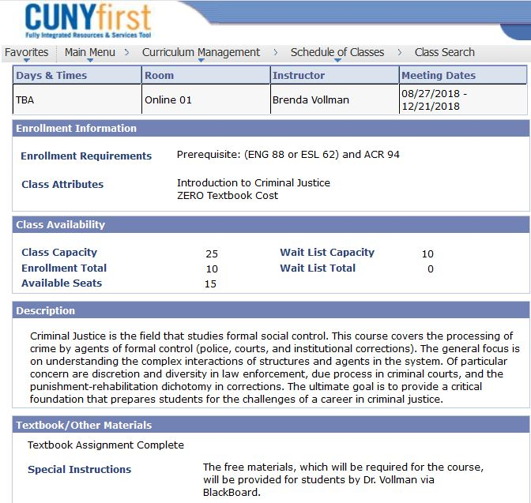

Slide 6
Copyright for educational purposes
Fair use is complex, but policing is limited
Educators, under most circumstances, may copy
  One book chapter
  Excerpts up to 10 percent of the original work
  250 words poems, or up to 250 words of a longer poem
  an article, short story, or essay of 2,500 words or less, or excerpts of up to 1,000 words or 10 percent of a longer work, whichever is less; or
  a single chart, graph, diagram, drawing, cartoon, or picture from a book, periodical, or newspaper
Columbia Fair Use Checklist

Slide 7
Creative Commons Licensing
Creative Commons (CC) licenses: Standard open licenses
CC licenses: Clearly explain permissions and conditions of reuse, and don’t require any additional permission to use or adapt
License selection tool

Slide 8
Finding OER: Materials that exist
Mason OER Metafinder: Searches 16 repositories
Repositories
Textbooks
Curricula
Open Courses
Video; Music; Photos
Other institutions’ course maps and subject guides

Slide 9
Concerns pursuing OER
Labor intensive, especially initially
Quality of materials
Too few sections for ZTC
Time to redesign and the development of original material:
  Tenure-track faculty and promotion
  CUNY Community College teaching load has been 5/4 (moving to 4/4); would not have ben possible without financial incentives, and recognition of pedagogical initiative
  Challenge of ZTC degree: Providing enough sections
“Enclosures of commons” Bollier

Slide 10
Benefits of developing and using OER:
Intended and unintended consequences
Faculty reported feeling “happier,” “excited,” “energized,” “liberated,” and “confident.”
“The workshops . . . have given me the freedom to develop the course in ways that I see as more beneficial to the students.”
“It totally liberated me, from all sorts of ideas about texts and traditions.”
Students said: “I was able to have better access to everything and didn’t feel lost or as if I was missing something.”
“No excuse for not completing the work.”
“Learning from real world experience which is better than learning from the textbooks because it’s easier, better, simpler and understandable.”

Slide 11
Thank you
Michelle Ronda
mronda@bmcc.cuny.edu

